Slide 1
Corresponding Angles
Ms. Latham
Year 7

Slide 2
Learning Intentions
Students will be able to
Identify corresponding angles
Solve problems with corresponding angles

Slide 3
24
7
30
Topic: Corresponding Angles
Date:
EQ – What are corresponding angles?
What are parallel lines?
Two lines that never meet or cross
What is a transversal line?
A line that cuts through other lines
What is corresponding?
Corresponding means matching

Slide 4
24
7
30
Topic: Corresponding Angles
Date:
EQ – What are corresponding angles?
What are corresponding angles?
When a transversal line cuts through two parallel lines, four pairs of corresponding angles are formed.
The corresponding angles are equal
Individual: Draw two parallel lines on your page and a transversal line. Measure all the angles!

Slide 5


Slide 6
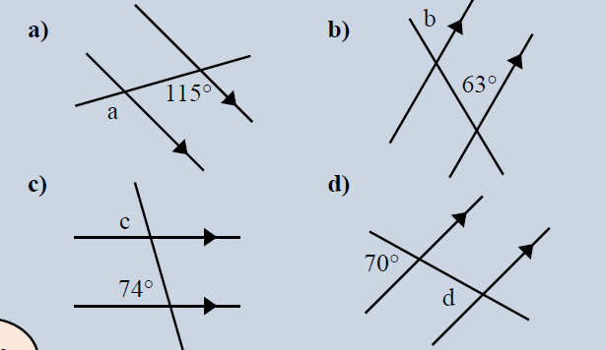
Guided Practice
Draw these on your left hand side!
Notes:
Draw 3-4 angles on the board going through each step.

Slide 7
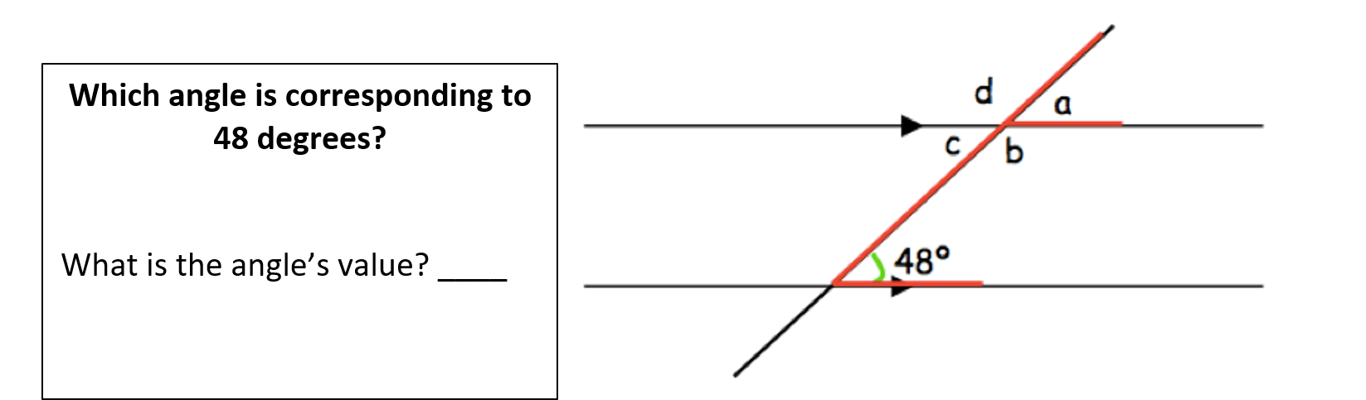
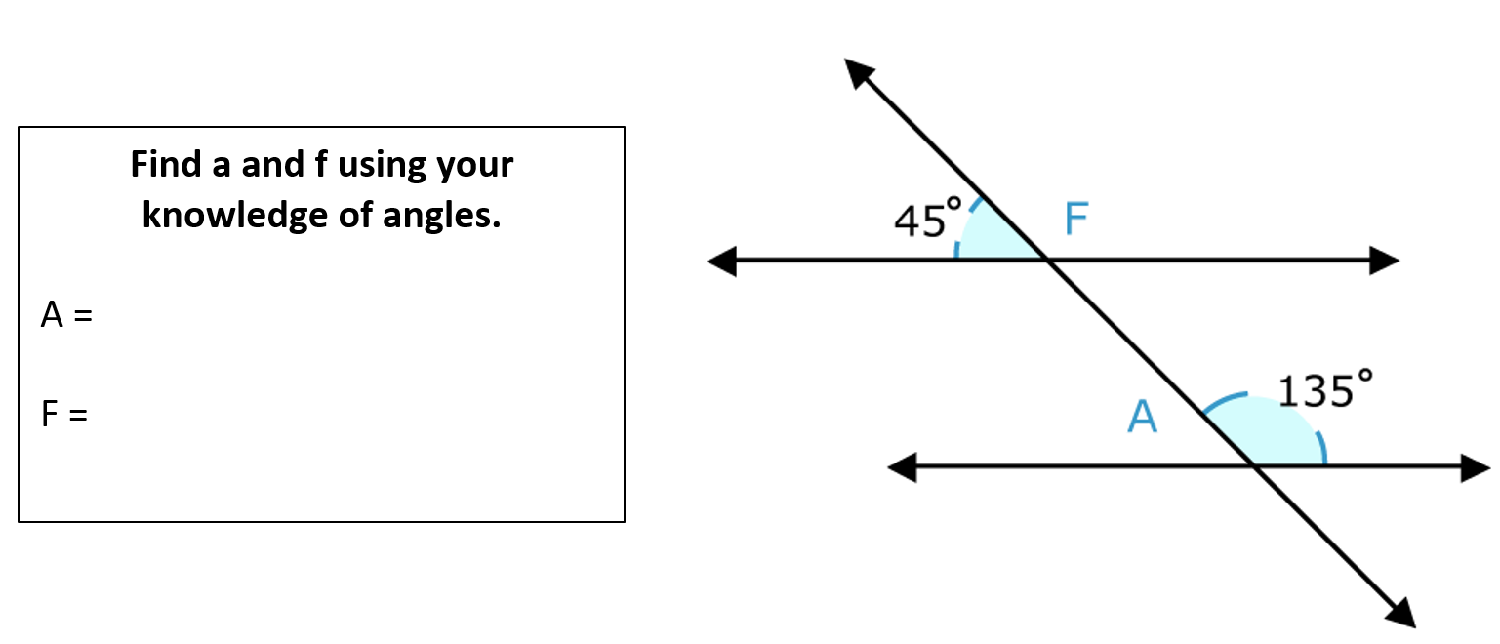
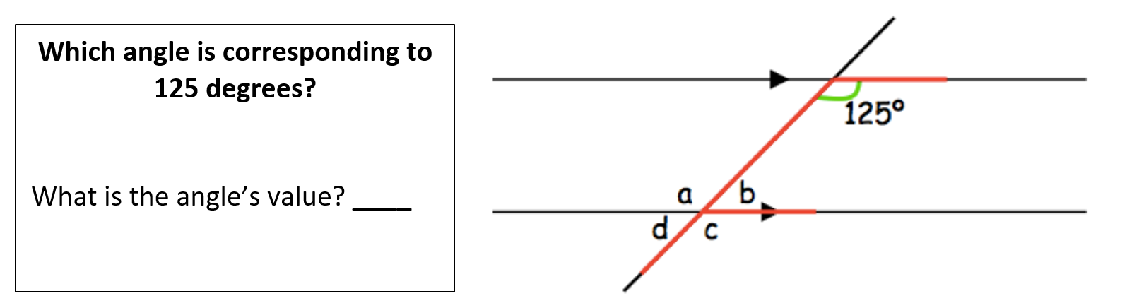
You can work together to solve the following questions.

